Slide 1
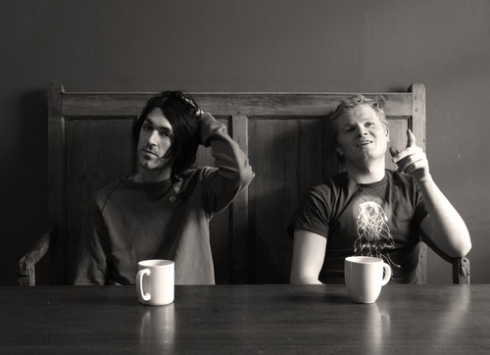
Duologues & sCENES
Drama
Year 9
Lesson 1 Units & Actioning

Slide 2
LESSON OBJECTIVES
1.To understand and be able to use the concepts of uniting and actions within a scene.
2.To unit and action your given script.

Slide 3
LESSON OUTCOME
LEVEL 4
I will know what uniting and actions are in relation to Drama.
LEVEL 5
I will understand how to use uniting and actions in relation to Drama.
LEVEL 6
I will be able to implement uniting and actions in my scene effectively, in relation to Drama.

Slide 4

STARTER
A quick introduction to the focus for the unit for duologues and scenes; and for this session. This session is going to be looking at uniting and actions in relation to Drama.

Slide 5

OBSERVATIONS
Students will be chosen to look at an object.
Students have 30 seconds to look at the object.
Students must then describe the object to the best of their ability.
Students must give as many details as possible

Slide 6
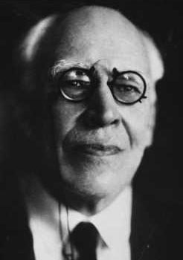
UNITS AND OBJECTIVES
STANISLAVSKI’S CHICKEN THEORY

Slide 7
BREAKFAST, LUNCH AND DINNER
One pair of students will improvise a conversation about what they had for breakfast.
One pair of students will improvise a conversation about what they had for lunch.
One pair of students will improvise a conversation about what they had for dinner.
Play all three scenes at the same time, then break up the conversations and play one at a time.
We have exactly the same conversations taking place, but because we have split them up we can understand more and enjoy it.

Slide 8
UNITS AND OBJECTIVES
Finding an action for a particular moment or line of text is dependant upon understanding the Stanislavskian concept of units and objectives (sometimes called episodes and tasks). In each unit of the text, you must decide on your objective (what your character wants) before defining the action (how your your character sets out to get it).

Slide 9
UNITS AND OBJECTIVES HOW TO BEGIN
Begin by breaking the scene up into units, each containing a single defined objective. The scene is broken into different sections or ‘units’ in order to be investigated. Each unit has its own title, which describes what that unit is about, and each character has his or her own objective at the heart of that unit.

Slide 10
UNITS AND OBJECTIVES
Units can be major (whole sections of text) or minor (a single word or short sentence), so a characters’ objectives are major or minor according to how the scene develops.

Slide 11
UNITS AND OBJECTIVES
Stanislavski warns “You should not try to express the meaning of your objectives in terms of a noun. That can be used for a unit but the objective must always be a verb.” Take the word ‘power’, for example. Turn it into an objective: ‘I want power.’ On its own, this is too general and, therefore, unplayable. Introduce something more definitely active and the objective is better defined: ‘I want to do something to obtain power.’ The ‘something’ element of the equation helps you find your action for the unit.

Slide 12
HOW TO ACTION THE TEXT
What we say and what we think or mean don’t always correspond. Take the most straightforward sentence: ‘Would you like a coffee?’ You could say that the speaker’s objective is simply ‘I want to offer you a drink’ but, more likely, there are a whole host of deeper impulses operating underneath the surface. The objective is more likely to be along the lines of ‘I want you to be relaxed’, ‘I want to show you I care’, ‘I want you to stay the night’ and so on.

Slide 13
ACTIONS SPEAK LOUDER THAN WORDS
Actioning offers an immediate way of achieving this objective. The action word is a succinct and specific transitive verb which describes what your character is actually doing to another character. ‘Would you like a coffee?’ could be played in many ways, according to the context of the scene and the characters objective. Different action words might be seduce, welcome, dominate, admire, fear, manipulate…The choice is virtually limitless – but must always be determined by the character’s objective.

Slide 14
TRANSITIVE VERBS
A transitive or active verb is a verb (‘a doing word’) that you can actively do to someone else. A useful way to identify if a verb is transitive is to place it between the words ‘I’ and ‘you’ and see if the sentence makes sense. So, in the case of encourage and charm, ‘I encourage you’, ‘I charm you’, make sense and so these verbs must be transitive. They express an action between characters and can define the impulse under each sentence.

Slide 15
UNITS AND OBJECTIVES
THE ORDER TO REMEMBER
Unit the scene – Change of element i.e thought or idea.
Determine your objective in each unit.
Title each unit.
Determine your actioning for each line, working from your objective in that unit.
Determine your objective for the entire scene.

Slide 16
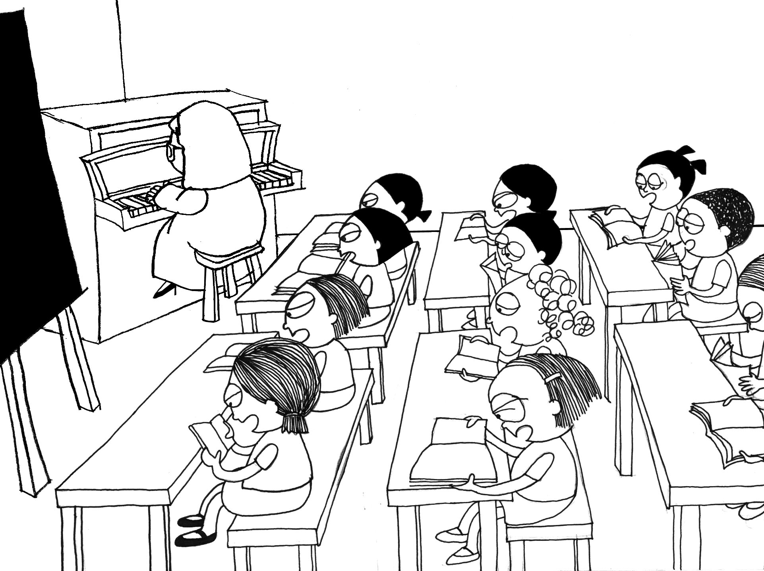
WHOLE CLASS UNIT
Sit in a circle.
As a whole class let’s unit a script together.
All students must get involved.
If in doubt ask as you will have to do it on your own soon!
Notes:
L1 resource script 1

Slide 17
SCRIPTS
Students will be put into groups.
Students will be given their scenes.
As a group read through your script.
Unit your script as a group so that you all have the same sections.
Notes:
The scripts will need to be cater to the class and the student groups will already need to have been decided.

Slide 18
What did you achieve today? LESSON OUTCOME
LEVEL 4
I will know what uniting and actions are in relation to Drama.
LEVEL 5
I will understand how to use uniting and actions in relation to Drama.
LEVEL 6
I will be able to implement uniting and actions in my scene effectively, in relation to Drama.

Slide 19
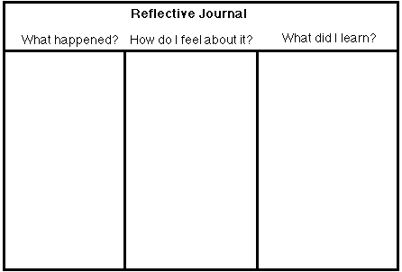
REFLECTIVE LOG
It is important to reflect on every lesson and begin thinking about setting targets for yourselves. For assessment it is important to keep a log book of activities, so you must write a reflective log for each lesson.

